Slide 1
Data Base
Creators:
Osama Saleh , Albara’a Almaseidiyen

Slide 2
Data Requirements Statements:
1. The system needs to store employee information, including name, employee ID, and contact details(phone number, Email).
2. Products must be tracked, including their ID, name and description
3. Customers' details, such as ID, name, address, and contact information (phone number, Email), need to be recorded.
4. Sales transactions must be logged, capturing the date, time , ID and total amount.
5. Inventory data is required to manage the stock levels and stock quantity of each product.
6. Supplier information, including name and ID, should be stored for supply chain management.
7. Financial records, including ID, expenses and revenue, must be tracked for accounting purposes.
8. The system should store information about company locations, including ID and address.
9. Every Sales transaction must manage by one employee at most.
10. Products purchased in sales transactions.
11. Customers buying products from sales transaction.
12. Products stored in inventory.
13. The supplier provides you with the products.
14.Every employee work in one of the company locations.
15. Financial Records record every sale transaction.

Slide 3
ER Diagram Outline:
1. Entities:
- Employee
- Product
- Customer
- SalesTransaction
- Inventory
- Supplier
- FinancialRecord
- CompanyLocation
2. Relationships:
- Employee-SalesTransaction (1:N)
- Product-SalesTransaction (M:N)
- Customer-SalesTransaction (M:1)
- Inventory-Product (1:1)
- Supplier-Product (1:N)
- Employee-CompanyLocation (M:N)
- FinancialRecord-SalesTransaction (M:1)

Slide 4
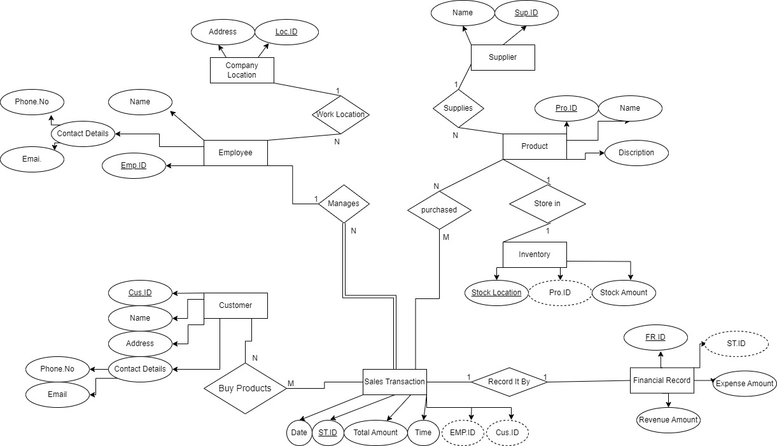
ER Diagram

Slide 5
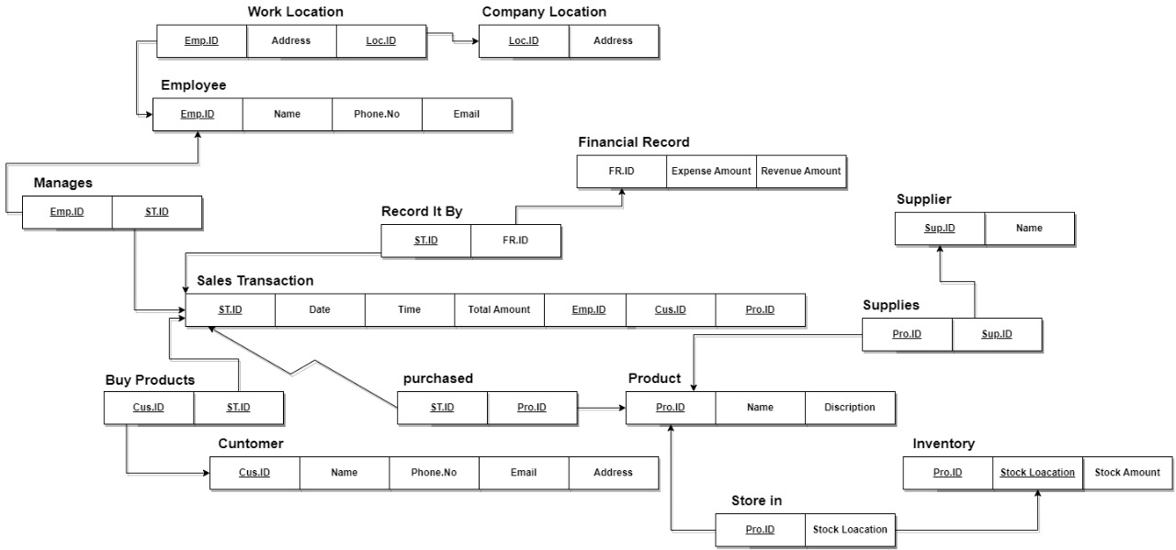
Schema

Slide 6
Thanks for watching
Osama , Albara’a

